Slide 1
Topics (Part 1)
Economics
Principles of Economics
Problem of Scarcity
Demand
Supply
Utility
Time value of money
Inflation and Deflation
Determination of price
Consumer Optimization
Consumer Response
Consumer Demand Curve

Slide 2
Learning Objectives
Principles of microeconomics
Scarcity - the basic economic problem
Demand and supply - Interaction
Utility and utility of money
Inflation and Deflation - Effect on economy and Society

Slide 3
Economics - Definition
“Economics is the study of the ALLOCATION of SCARCE resources to meet unlimited human wants.”
Economics is the study of how society manages its scarce resources.
Economics is the study of economic problems of the people living in a community.
For the production and distribution of wealth
Economics is the science which studies human behaviour which aims at meeting maximum objectives of an individual with the help of scarce means i.e., limited means (or scarce resources)

Slide 4
Scarcity - The Basic Economic Problem
“Scarcity refers to a gap between limited resources and theoretically limitless wants.”
Scarcity refers to resources being finite and limited.
How and what to produce from these limited resources.
There is a constant opportunity cost involved in making economic decisions.
The next best alternative that must be foregone as a result of a particular decision
Examples: Land, Water scarcity, Labour shortages etc.

Slide 5
Principles of Economics
Economics is the study of how society manages its scarce resources
Economists therefore study how people make decisions
How much they work?
What they buy?
How much they save? and
How they invest their savings ?
and also, How people interact with one another?

Slide 6
Principles of Economics
How People Make Decisions
Principle 1 : People face Trade - Offs
Making decisions requires trading off one goal against another. To get one thing that we like, we usually have to give up another thing that we like.
Getting the maximum benefits from its scarce resources
Benefits are distributed uniformly among society's members
Principle 2 : The Cost of Something is What you Give up
The opportunity cost of an item is what you give up to get that item. When making any decision, decision makers should be aware of the opportunity costs that accompany each possible action.

Slide 7
Principles of Economics
How People Make Decisions
Principle 3 : Rational People Think at the Margin
Rational people systematically and purposefully do the best they can to achieve their objectives, given the available opportunities.
Rational people often make decisions by comparing marginal benefits and marginal costs.
Marginal changes is the small incremental adjustments to an existing plan of action
Principle 4 : People Respond to Incentives
An incentive is something that induces a person to act, such as the prospect of a punishment or a reward. Because rational people make decisions by comparing costs and benefits, they respond to incentives.

Slide 8
Principles of Economics
How People Interact
Principle 5 : Trade can Make Everyone Better Off
By trading with others, people can buy a greater variety of goods and services at lower cost.
Trade allows to specialize in what they do best and to enjoy a greater variety of goods and services.
Principle 6 : Markets - Organizes Economic Activity.
Firms decide whom to hire and what to make.
Households decide which firms to work for and what to buy with their incomes.
These firms and households interact in the marketplace, where prices and self-interest guide their decisions.

Slide 9
Principles of Economics
How People Interact
Principle 7 : Govt. can Improve Market Outcomes
Enforce property rights so individuals can own and control scarce resources.
Promote efficiency
Promote equality.

Slide 10
Principles of Economics
How Economy as a Whole Works
Principle 8 : Standard of Living Depends on Production
Almost all variation in living standards is attributable to differences in country’s productivity - that is, the amount of goods and services produced from each unit of labor input.
Principle 9 : Prices Rise When Too Much Money is Printed
In almost all cases of large or persistent inflation, the culprit is growth in the quantity of money. When a government creates large quantities of the nation's money, the value of the money falls

Slide 11
Principles of Economics
How Economy as a Whole Works
Principle 10 : Inflation and Unemployment
Increasing the amount of money in the economy stimulates the overall level of spending and thus the demand for goods and services.
Higher demand may over time cause firms to raise their prices, but in the meantime, it also encourages them to hire more workers and produce a larger quantity of goods and services.
More hiring means lower unemployment.

Slide 12
Demand
Is the rate at which consumers want to buy a product.
Economic theory holds that demand consists of two factors: taste and ability to buy.
Taste, which is the desire for a good, determines the willingness to buy the good at a specific price.
Ability to buy means that to buy a good at specific price, an individual must possess sufficient wealth or income.

Slide 13
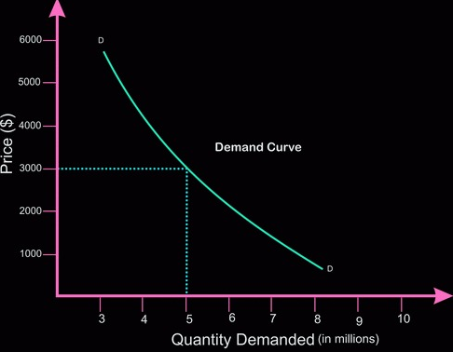
Demand

Slide 14
Supply
Willingness and ability to supply goods determine the seller's actions.
At higher prices, more of the commodity will be available to the buyers.
This is because the suppliers will be able to maintain a profit despite the higher costs of production that may result from short-term expansion of their capacity.

Slide 15
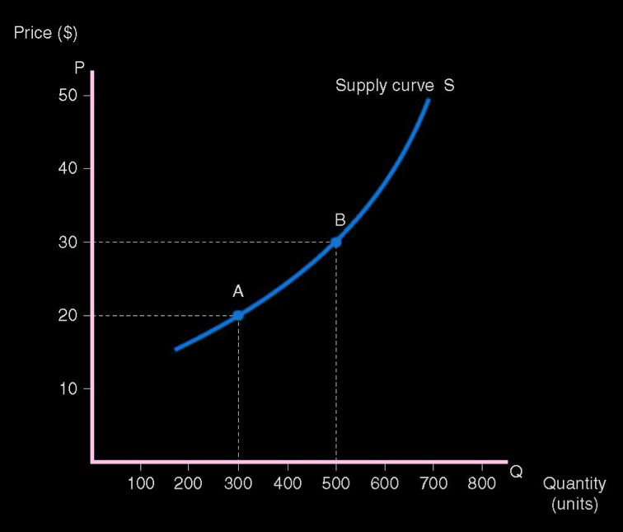
Supply

Slide 16
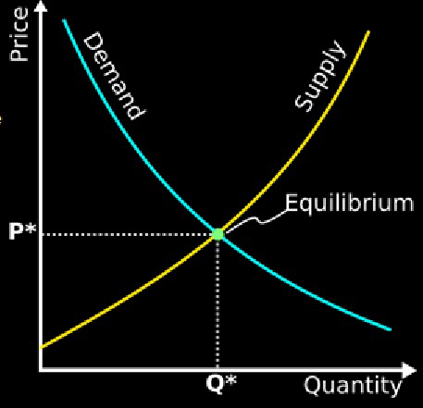
Interaction Between Supply and Demand
Buyers and sellers react in opposite ways to a change in price.
When price increases, the willingness and ability of sellers to offer goods will increase, while the willingness and ability of buyers to purchase goods will decrease.

Slide 17

Time Value of Money
Refers to the idea that money available immediately is worth more than the same amount worth some time in the future.
This is because the money can earn interest, hence is worth more the earlier that it is received.
The future value (FV ) of Principal $PV earning interest rate i% for n times periods is

Slide 18
Time Value of Money
For example,
If interest rates were 5%, then $100 that is invested today will become $105 in a year.
Conversely, $100 received in a year, is only worth $100 / 1.05 = $95.24 today.
Hence, it is better to receive $100 today, than it is to receive $100 in a year

Slide 19
Inflation and Deflation
Inflation occurs when the prices of goods and services rise, while deflation occurs when those prices decrease.
Inflation
Inflation is a quantitative measure of how quickly the price of goods in an economy is increasing. Inflation is caused when goods and services are in high demand, thus creating a drop-in availability.
The most common measure of inflation is the Consumer Price Index (CPI).

Slide 20
Inflation and Deflation
Deflation
Deflation occurs when too many goods are available or when there is not enough money circulating to purchase those goods. As a result, the price of goods and services drops.
Companies that find themselves stuck with too much inventory must cut costs, which often leads to layoffs. Unemployed individuals do not have enough money available to purchase items; to coax them into buying, prices get lowered, which continues the trend.

Slide 21
Utility Analysis
The level of happiness or satisfaction that a person receives from his or her circumstances.
Utility is a measure of well-being and, according to utilitarians, is the ultimate objective of all public and private actions.
The proper goal of the government, they claim, is to maximize the sum of utility achieved by everyone in society.

Slide 22
Total and Marginal Utility
Total utility (TU)
The total satisfaction received from consuming a good or service.
Marginal utility (MU)
The extra utility received from consuming one additional unit of a good

Slide 23
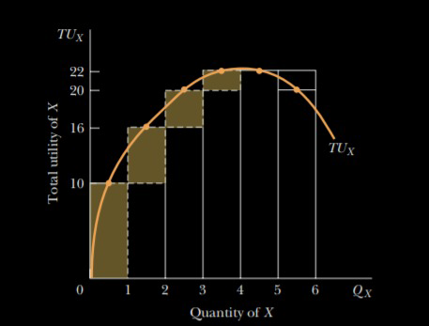
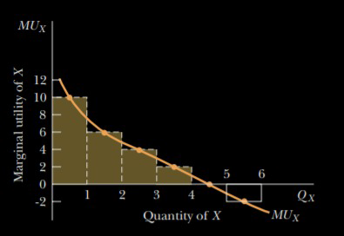
Total and Marginal Utility

Slide 24
Topics (Part 2)
Intellectual Property Rights
IPR
Patents
Licensing and Technology transfer
Designs and Utility Models

Slide 25
Intellectual Property
“Intellectual property refers to creations of the mind: inventions; literary and artistic works; and symbols, names and images”

Slide 26
Intellectual Property Rights
“Intellectual Property Rights (IPR), very broadly, are rights granted to creators and owners of works that are results of human intellectual creativity. These works can be in the industrial, scientific, literary and artistic domains, which can be in the form of an invention, a manuscript, a suite of software, or a business name”

Slide 27
Intellectual Property Rights
Patents
Copyrights and related rights
Trade Marks
Geographical Indications
Industrial Designs
Layout Designs of Integrated Circuits
Protection of Undisclosed Information (Trade Secrets)
Plant varieties

Slide 28
Intellectual Property Rights
The importance of intellectual property was first recognized in the Paris Convention for the Protection of Industrial Property (1883) and the Berne Convention for the Protection of Literary and Artistic Works (1886). Both treaties are administered by the World Intellectual Property Organization (WIPO).

Slide 29
Why promote and protect Intellectual Property?
There are several compelling reasons.
The progress and well-being of humanity rest on its capacity to create and invent new works in the areas of technology and culture.
The legal protection of new creations encourages the commitment of additional resources for further innovation.
The promotion and protection of intellectual property spurs economic growth, creates new jobs and industries, and enhances the quality and enjoyment of life.

Slide 30
Patents
“A patent is a form of intellectual property that gives its owner the legal right to exclude others from making, using, or selling invention for a limited period of years in exchange for publishing an enabling public disclosure of the inventions. A patent provides patent owners with protection for their inventions. Protection is granted for a limited period, generally 20 years.”

Slide 31
Patents - Conditions to be satisfied
Novelty
For an invention to be judged as novel, the disclosed information should not be available in the 'prior art'.
Inventiveness (Non-obviousness)
A patent application involves an inventive step if the proposed invention is not obvious to a person skilled in the art i.e., skilled in the subject matter of the patent application.
Usefulness
An invention must possess utility for the grant of patent. The utility requirement often has been interpreted to mean that an invention must have a real use that can be demonstrated.

Slide 32
Patents - Patentable Inventions under the Patents Act, 1970
Art, process, method or manner of manufacture.
Machine, apparatus or other article, Substances produced by manufacture, which include any new and useful improvements of any of them and an alleged invention.
However, inventions claiming substance intended for use, or capable of being used, as food or as medicine or drug or relating to substances prepared or produced by chemical processes (including alloys, optical glass, semiconductors and inter-metallic compounds) are not patentable.

Slide 33
Patents - Types of Inventions which are not Patentable in India
Claims anything obviously contrary to well established natural laws
Contrary to law or morality or injurious to public health
Discovery of a scientific principle or formulation of an abstract theory
Discovery of any new property or new use of known substance or the mere use of a known process, machine or apparatus unless such a known process results in a new product or employs at least one new reactant

Slide 34
Patents - Types of Inventions which are not Patentable in India
Arrangement or rearrangement or duplication of features of known devices
A method or process of testing applicable during the process of manufacture
A method of agriculture or horticulture
Any process for medical, surgical, curative, prophylactic or other treatment of human beings, or any process for a similar treatment of animals or plants.

Slide 35
Why are patents necessary?
Patents provide incentives to individuals by recognizing their creativity and offering the possibility of material reward for their marketable inventions. These incentives encourage innovation, which in turn enhances the quality of human life.

Slide 36
What rights do patent owners have?
A patent owner has the right to decide who may – or may not – use the patented invention for the period during which it is protected.
Patent owners may give permission to, or license, other parties to use their inventions on mutually agreed terms.
Owners may also sell their invention rights to someone else, who then becomes the new owner of the patent.
Once a patent expires, protection ends and the invention enters the public domain. This is also known as becoming off patent, meaning the owner no longer holds exclusive rights to the invention, and it becomes available for commercial exploitation by others.

Slide 37
Technology Transfer
“Technology transfer is defined as the process where
Knowledge
Skills and
Equipment
are transferred. "

Slide 38
Technology Transfer
Technology Transfer (also called Transfer of Technology (TOT) and Technology Commercialization) are the processes by which the information or knowledge related to the technological aspects travel within the group or between the organizations or entity.
Taking this to the broader scenario, give rise to International technology transfer in which the knowledge travels in between the countries, which is not only limited to the Knowledge and information, rather includes skill transferring, methods of manufacturing, physical assets, know-how, and other technical aspects, and henceforth helps in further development of the technology and innovation, by effectively utilizing the technology transferred and finally incorporating it.

Slide 39
Technology Transfer
The mechanisms of transfer can be categorized in two
External (Formal)
Is the Result of conscious decisions (e.g. going to seminars, attending conferences etc.) and can therefore be controlled and managed.
Internal (Informal)
Certain aspects of internal transfer can also be controlled, but there are aspects like informal discussions in the workplace or the obtaining of information from experienced co-workers that cannot be controlled.

Slide 40
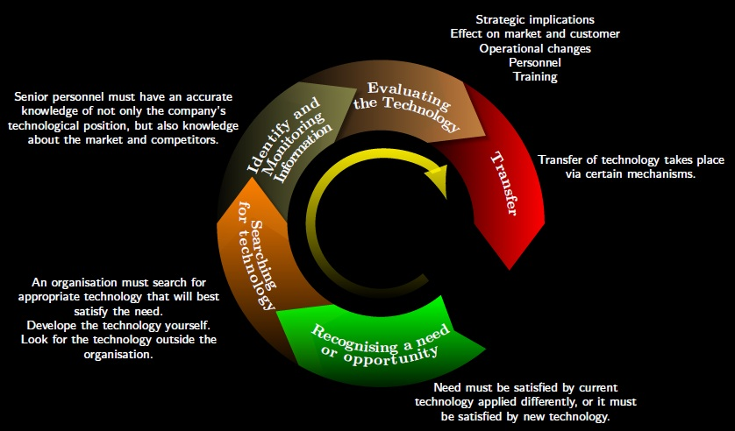
Technology Transfer

Slide 41
Technology licenses & Technology Transfer
Technology licenses allow an organization or person to make use of some technology that might be protected by a variety of intellectual property, including patents. It is primarily involved in the act of permitting a target organization to do something with the permission of the grantor of the license.
Technology transfer is a broader concept that seeks to enable a target organization to up-skill on a technology. It could involve a technology license as well (including patents), but its primary focus is to educate a target organization in a technology to either get a product to market or to create an industry or an academic impetus.

Slide 42
Utility Models
Utility models protect new technical inventions through granting a limited exclusive right to prevent others from commercially exploiting the protected inventions without consents of the right holders.

Slide 43
Utility Models
Utility model protection means that the invention cannot be commercially made, used, distributed, imported or sold by others without the utility model owner's consent for a limited period, often 6 to 15 years from the filing date.

Slide 44
What are the main differences between utility models and patents?
The term of protection for utility models is shorter than for patents, and varies from country to country (usually between 6 and 15 years).
In most countries, patent offices do not examine utility model applications as to substance prior to registration. This means that the registration process is often simpler and faster, some times it takes six months or less.
Fees for obtaining and maintaining utility models are cheaper.
In some countries, utility model protection can only be obtained for certain fields of technology, such as mechanical devices and apparatus, and only for products but not for processes.

Slide 45
Industrial Designs and Utility models
Industrial Designs protect the external configuration or appearance of an object, while Utility Model protects the technical function of an invention

